Slide 1





PROBLEM STATEMENT
Perishable food products such as fruits, vegetables, dairy and meat lose quality or spoil quickly if they’re not kept within the right temperature and humidity during transport and storage. Today, most monitoring is manual or very basic. When conditions go wrong, businesses only find out after products are damaged — leading to high losses, wasted transport costs, dissatisfied customers and even regulatory issues.

Slide 2




SOLUTION
We have created an IoT-based monitoring system and tracking platform designed specifically for perishable goods.
It combines sensors, cloud services, and a mobile app to give end-to-end visibility and control to everyone in the supply chain.

Slide 3

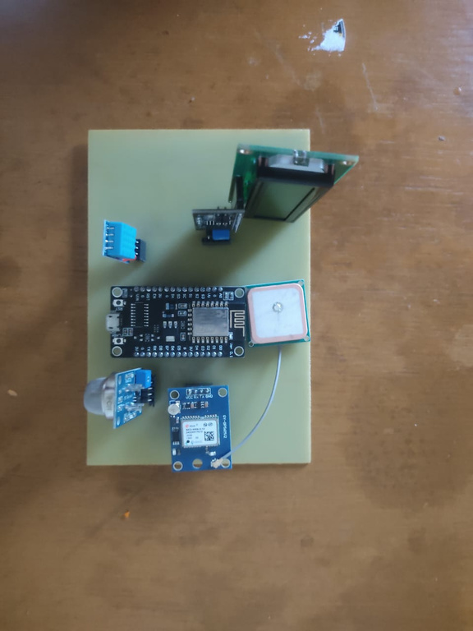
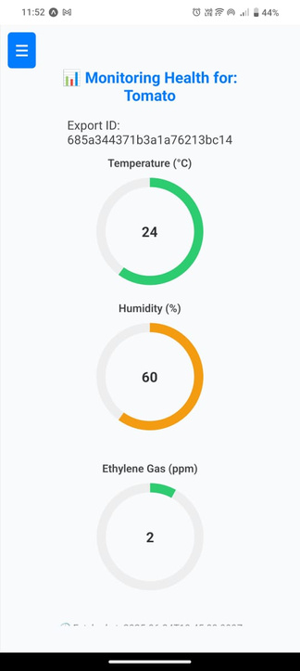
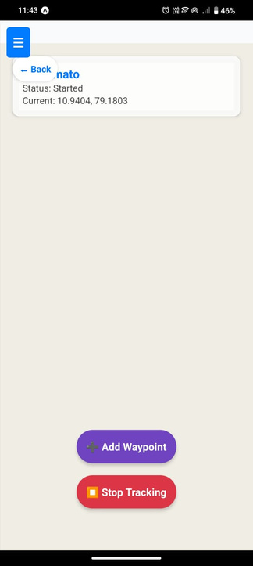
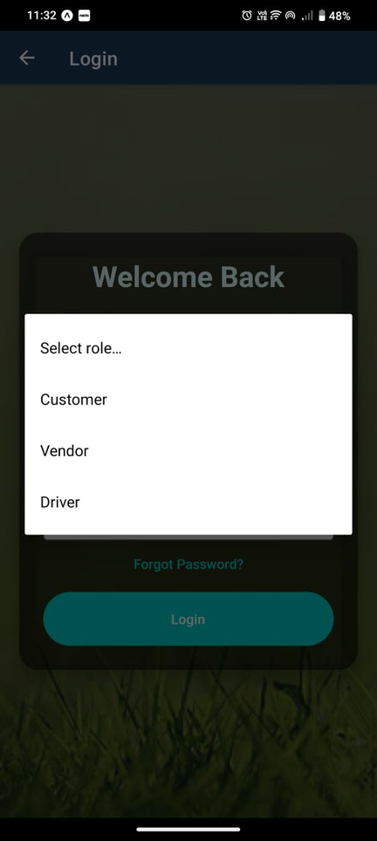
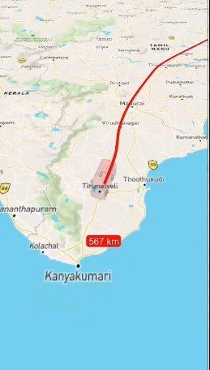
SAMPLE OUTPUT
01
02
03
04
Smart IoT Sensors
Cloud Connectivity & Dashboard
Vehicle Tracking
Connected Ecosystem

Slide 4










UNIQUE SELLING POINTS
Connected Ecosystem:
Driver + Vendor + Customer
Vehicle Tracking + Environmental Monitoring in One Unified System
Proactive Alerts along with Predictive Analytics
Affordable, Scalable for SME
Rich Stakeholder Communication (Multi-party notifications)
Real-Time Visibility for All Parties / Transparency

Slide 5
COMPETITION & BARRIER TO ENTRY
COMPANY
WHAT THEY OFFER
HOW IT DIFFERS
MONITOR
MONITOR
+
PREDICTIVE ANALYSIS
GND SOLUTIONS
Temperature
Humidity
Location
WEB
&
MOBILE APPS
AWL INDIA
ECO SYSTEM
MONITOR
+
PREDICTIVE ANALYSIS
REAL TIME ALERTS
DIRECT CUSTOMER INTEGRATION
DATA TRANSPARENCY
IOT-WORKS

Slide 6



REVENUE MODEL
REVENUE MODEL
TOP CASH BURN AREAS
Subscription (SaaS): Monthly/annual fee per truck or cold-storage unit for real-time monitoring dashboard.
Hardware Sales: One-time sale of sensor kits & trackers at cost + margin.
Premium Add-ons: Analytics reports, compliance certificates, API access for large customers.
Hardware R&D & prototyping (sensors + controllers).
Cloud infrastructure & mobile app development.
Hiring (sales team, support, tech talent).
Customer acquisition (events, demos, digital marketing).
3–5 YEAR PROJECTION
Year 1: Pilot customers, ~₹50 L revenue.
Year 3: 1,500+ units subscribed, ₹10 L ARR.
Year 5: Pan-India expansion, 10,000+ units, ₹1 Cr ARR.

Slide 7













TARGET MARKET
Age 30–55
Tier-1 & Tier-2 cities
Cost-sensitive but tech-open; want less spoilage & easy dashboards
Mid-sized food exporters, cold storages & transporters in India.
Goal: capture 1–2% of Indian monitoring market in 3–4 years .
Direct B2B sales & demos
Partnerships with logistics firms & packaging suppliers
Digital marketing
Industry exposure & referral programs
Global cold-chain logistics.
Indian cold-chain market.
OUR TARGET
MARKET SIZE
CUSTOMER PROFILE
CHANNELS

Slide 8










OUR PRODUCT
Keeps food fresh:
Stops losses:
01
Our small sensor kit tracks temperature & humidity inside trucks or storage rooms in real time.
If conditions go wrong, alerts go instantly to drivers & managers to fix it before spoilage.
02
Easy for everyone:
Connects all parties:
03
All data shown on a simple mobile app/dashboard — no tech skills needed.
04
Driver, vendor & customer see the same information, reducing disputes & delays.
Saves money & builds trust:
SDG Goals:
05
Less waste = lower costs,
better quality = happier customers & stronger brand.
SDG-2: Zero Hunger
SDG -9: Industry Innovation and infrastructure
.
06

Slide 9









MILESTONES
STEP 01
STEP 02
STEP 03
STEP 04
STEP 05
PROBLEM
STATEMENT
SOLUTION
PROTOTYPING
TESTING
REFINEMENT

Slide 10
FUNDING NEEDED
PHASE
USE OF FUNDS
AMOUNT (₹)
TIMELINE
Sensor & Controller Finalisation
Combine 3 sensors + controller, PCB design, enclosure
₹ 3 lakh
4–6 months
Cloud & Mobile App Development
Dashboard, alerts, integration with GPS tracking
₹2 lakh
6–8 months
₹6 lakh
Pilot Manufacturing
Build & deploy 100–150 kits for first customers
6–9 months
Marketing &
Sales Setup
Demos, travel, early partnerships, digital marketing
₹2 lakh
6–9 months
6–9 months
Operations & Support
Hiring 1–2 tech/support staff, basic infra
₹3 lakh

Slide 11








PROFILE
THARUN KUMAR M
SUHASH V
MOTHI BALAAJI V
NITHEESH S
Test product or service concepts to ensure market demand.
Secure funding sources to support early development.
Build products that meet validated market needs.
Launch products on a large scale and plan for growth.
01
02
03
04

Slide 12
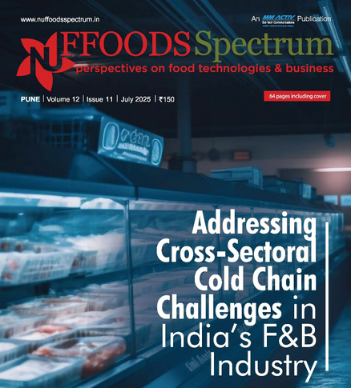

REFERENCES
India produces over 400 million metric tonne (MT) of perishable food annually, yet 30–40 per cent of fruits and vegetables and up to 16 per cent of marine products spoil……
Farmers in India incur nearly USD 12,520 million in post-harvest losses annually due to inadequate cold storage facilities. BASE and Empa’s ‘Your Virtual Cold Chain Assistant’ project is making sustainable cooling accessible.....

